Slide 1


Perception versus Reality
IMPACT LAB
PRINCIPAL INVESTIGATOR: Chujun Lin
Comparing Subjective Perceptions and Objective Measurements of Attractiveness-Trait Correlations
Junsong Lu
Department of Psychology
University of California San Diego
April 23rd, 2025
Notes:
The current review paper focus on the subjectively perceived and measured correlation between attractiveness and traits like warmth, competence.

Slide 2
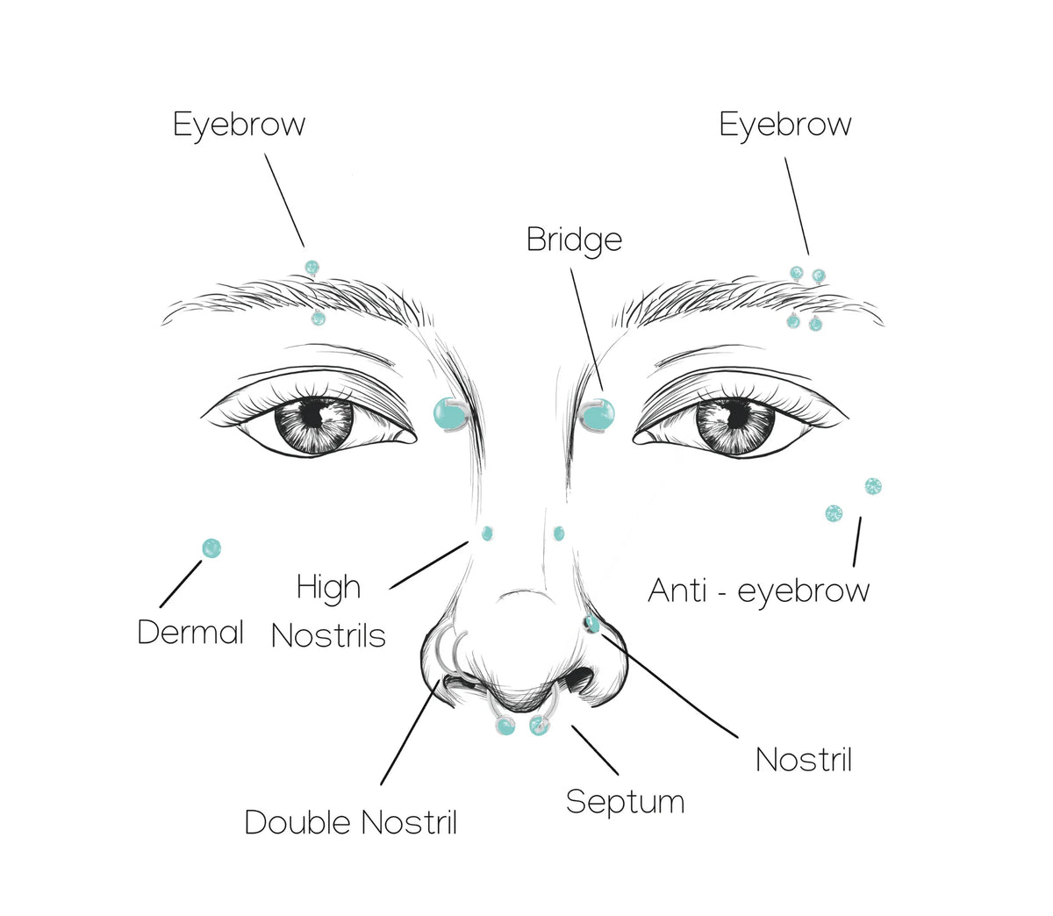
The Beauty-is-Good Effect
Attractive people are attributed as more socially desirable and competent.
Dion & Walster, 1972
Notes:
The key concept is the beauty-is-good effect, indicating that people tend to attribute positive qualities to physically attractive individuals. For example, attractive people are attributed to being more socially desirable and competent.

Slide 3
Research Background
1
1972
Dion and Walster introduced “what is beautiful is good”,
followed by subsequent explanations
2
1990s
Meta-analyses confirm effect is strong and widespread. Considered as stereotypes or biases
3
2000 to 2020
New theories refuting mere stereotype.
Ongoing debates…
Notes:
This idea was first introduced by Dion and Walster back in 1972. Over the years, studies—especially large meta-analyses in the 1990s—consistently supported it, concluding that the 'beauty-is-good' effect is mostly a stereotype. However, in recent decades, new theories have emerged suggesting the effect may also reflect \*some\* truth. The debate remains unresolved.

Slide 4
Outline & Goals
The current review aims to…
Reviewing and Comparing Perceived and Measured
Associations Between Attractiveness and Key Traits
1
The beauty-is-good effect: a pure stereotype or grounded in reality?
Re-evaluating Previous Theories and Proposing New
Explanations
2
New insights on why some theories predict—and others don’t?
Notes:
Given the ongoing debate, the current review aims to synthesize empirical evidence on both perceived and measured associations between physical attractiveness and key traits. While intelligence and health have dominated the literature, we also examine less studied traits to provide a more complete understanding of the topic. This combined analysis allows for direct comparison between stereotypical beliefs and empirical realities. Second, we evaluated these findings through theoretical lenses and propose new insights on why some theories predict empirical findings while others do not.

Slide 5
Empirical Findings
1
Eagjy et al. (1991)
Effect stronger in social competence domains
2
Feingold (1992)
Little covariance between attractiveness and measured traits (e.g., mental health)
3
Jackson et al. (1995)
A significant association between attractiveness and intelligence in children
Notes:
Before going to the first association between intelligence and attractiveness, I want to briefly review some early findings. In a meta-analysis, Eagjy et al. (1991) synthesized prior studies and demonstrated that the effect is not a uniformly generalizable phenomenon but is more pronounced in domains such as social competence and interpersonal ease. Rather than consider the beauty-is-good effect is a pure stereotype, the authors also suggest that social reality also contributes to the perceived association. However, in the subsequent study by Feingold, the author found little to null correlation between attractiveness and measure traits like intelligence and mental health. This result was further refuted by Jackson, who identified significant attractiveness-intelligence association among children.

Slide 6
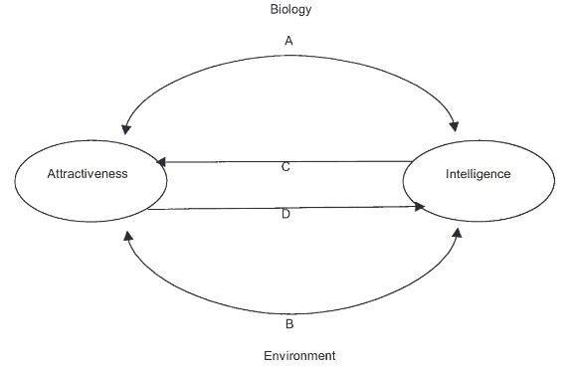
Attractiveness and Intelligence: A Developmental Model
Genetic factor
Environmental factor
Self-enhancement
Self-fulfilling prophecy
Zebrowitz et al. (2002)
Notes:
A central topic of the debate revolves around the association between attractiveness (A) and intelligence (I). In response to inconsistent findings, Zebrowitz et al. (2002) proposed an integrative developmental model identifying four distinct pathways that may explain the A-I relationship

Slide 7
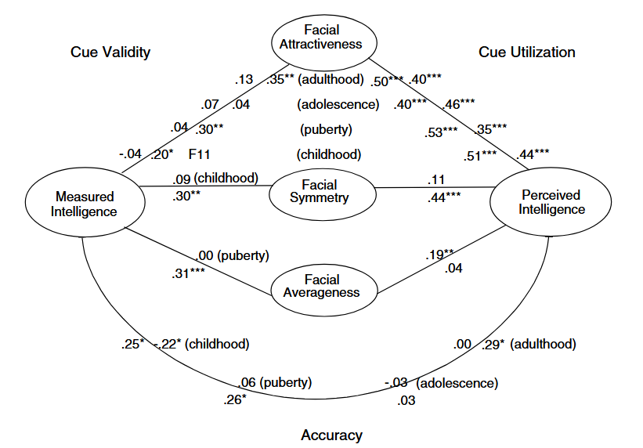
Attractiveness and Intelligence: The Bad Genes Hypothesis
Bad Genes Hypothesis
Attractiveness predicts intelligence at lower levels
Zebrowitz & Rhodes, 2004

Slide 8
Attractiveness and Intelligence: The Bad Genes Hypothesis
Bad Genes Hypothesis
Attractiveness predicts intelligence at lower levels
Face Overgeneralization Hypothesis
People overgeneralize association across full range
Zebrowitz & Rhodes, 2004
Notes:
Related to the bad genes hypothesis is the anomalous face overgeneralization hypothesis, which holds that the evolutionary importance of recognizing individuals with bad genes may have produced a strong preparedness to respond to their anomalous facial qualities that is overgeneralized to normal adults whose faces merely resemble those who are unfit

Slide 9
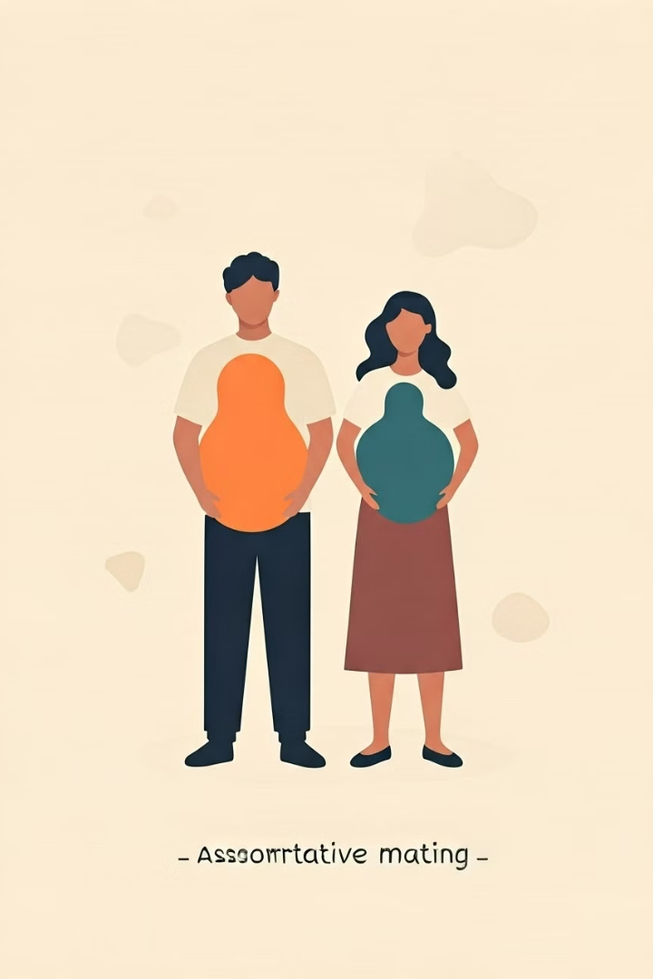
Assortative Mating Hypothesis I
Mating
Intelligent males tend to mate with attractive females
Offspring
Higher in both parental traits
Limitations
Predictive power limited in monogamous societies
(Kanazawa, 2004, 2006)
Notes:
An alternative evolutionary perspective, the assortative mating hypothesis (Kanazawa, 2004, 2006), offers distinct explanations for attractiveness-trait correlations.

Slide 10
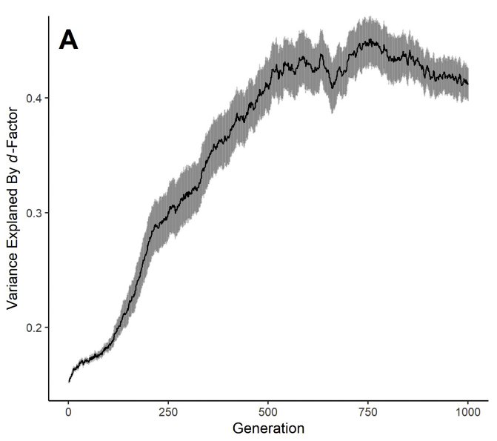

Assortative Mating Hypothesis II
Assortative mating
Not focus on covariation in traits themselves but on covariation in desirability.
Cross-character assortment
Assortative mating creates “cross-character assortment”: correlations between mated partners on otherwise independent traits (Buss & Barnes, 1986).
Conroy-Beam et al., 2019
Notes:
Mate value = overall desirability
There is another version of the AMH. Unlike the prior version, this version does not focus on covariation in traits themselves but on covariation in desirability
one sex's ideal preference is not maximal on a trait dimension.

Slide 11
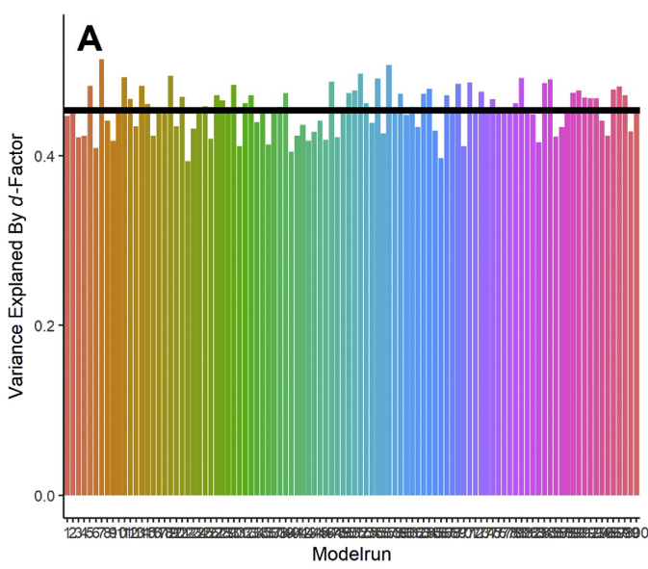
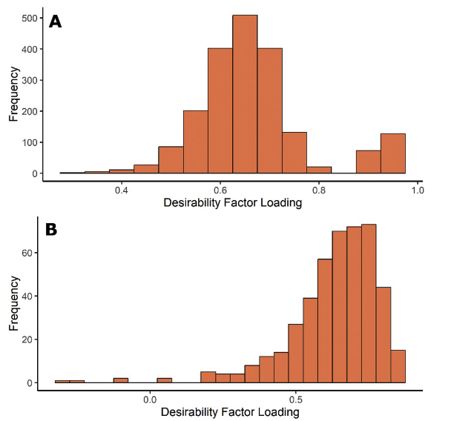
Assortative Mating Hypothesis II
A simulation of the beauty-is-good effect
Conroy-Beam et al., 2019
Notes:
people mate assortatively for some trait (e.g. physical attractiveness) (2) this trait can be accurately perceived, but (3) perceptions of this trait inspire biased ratings for other traits such that, for instance, physically attractive people are spuriously rated as possessing other desirable characteristics.
To rule out the alternative of the beauty-is-good effect, the author performed another simulation in which only facial attractiveness can be accurately evaluated, but other trait should be inferred from attractiveness. Indeed, they also found a single d-factor can account for most variance of traits, but…

Slide 12
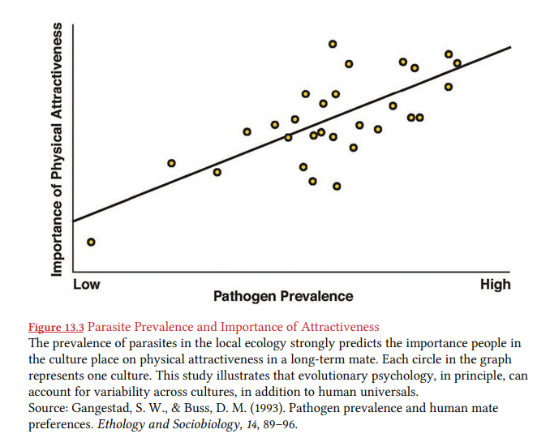
Attractiveness and Health
The Good Genes Hypothesis
Facial symmetry affects attractiveness because it is a certification of overall phenotypic quality and developmental health.
However, adolescent facial attractiveness was unrelated to adolescent health for either males or females, and was not predictive of health at the later times (Kalick et al., 1998).
Thornhill & Gangestad, 1993
Notes:
Besides the relationship between I and A, researchers also focus on health
Facial symmetry is hypothesized to affect positive beauty judgments because symmetry is a certification of overall phenotypic quality and developmental health, which may be importantly influenced by parasites.

Slide 13
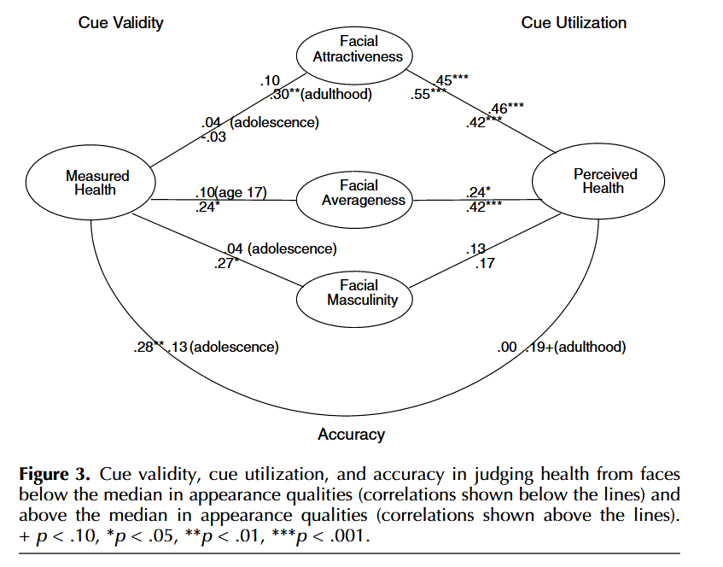
Attractiveness and Health
The Bad Genes Hypothesis
Facial attractiveness provides valid cues to health for faces in the lower but not the upper halves of the distributions of these facial qualities.
But the correlation is insignificant for adolescence (r = -.03)
Zebrowitz & Rhodes, 2004
Notes:
作者没解释为什么adolescence这里不符合预测

Slide 14
Attractiveness and Health
The Anomalous Face Overgeneralization
Hypothesis
Aims to explain the inflated correlation between attractiveness and perceived physical health.
Perceivers overgeneralize their sensitivity to anomalous cues across all attractiveness levels.
Zebrowitz & Rhodes, 2004
Notes:
And there is also a face overgeneralization hypothesis like in one of intelligence

Slide 15
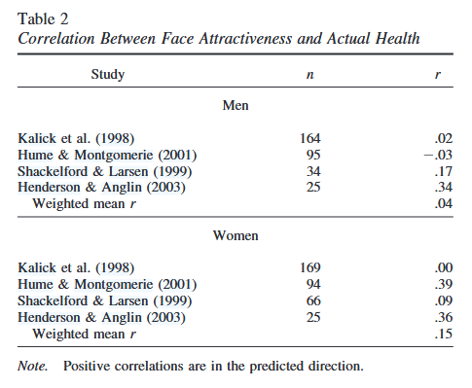

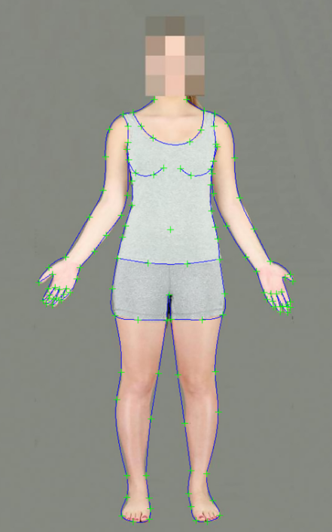

Attractiveness and Health
Low correlation between attractiveness and health
Facial attractiveness/adiposity
Waist-to-hip ratio/BMI
Physical health
Weeden & Sabini, 2005
Notes:
Subsequent meta-analysis synthesis these associations, however, they only found weak correlations between attractiveness and health.
Implications from Studies on Bodily Morphological Indicators may help understand this low correlation. These studies found that WHR and BMI are better predictors of physical health. These indicators are also correlated with facial A and adiposity. Therefore, A may serve as a distal rather than a proximal cue of physical health

Slide 16
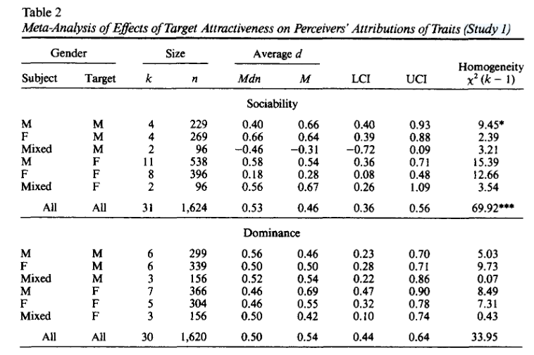
Attractiveness and Other Key Traits
Attractive individuals are perceived to be warmer and socially skilled, with medium‑sized effects for sociability, dominance, and general mental health than their less attractive counterparts.
Attractiveness is only trivially related to personality and cognitive measures, with the sole exception of a modest link to social skills (r = .23).
Feingold, 1992
Notes:
Researchers also investigated traits other intelligence and health. What they found is that

Slide 17
Comparing Perceived and Measured Associations Between Attractiveness and Key Traits
Intermediate conclusion: a clear pattern of correlation
inflation emerges in perceived versus actual trait associations.
e.g., attractiveness–health -.03~30 < attractiveness-perceived health .42~.54
Attractiveness appears to function as a more valid phenotypic
health marker than intelligence, with multiple studies
demonstrating modest but reliable associations.
(Bulczak & Gugushvili, 2023; Nedelec & Beaver, 2014; Sheehan & Hamermesh, 2024; Zebrowitz & Rhodes, 2004).

Slide 18
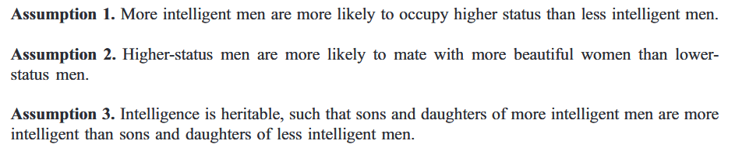
Re-evaluating the Assortative Mating Hypothesis
However, multiple traits can contribute to status seeking. An attractive female could pair with a highly intelligent but less aggressive male, or conversely with a highly aggressive but less intelligent male, or with a male demonstrating moderate levels of both traits.
(Kanazawa, 2004, 2006)
Notes:
To recap, there are 4 hypothesis

Slide 19
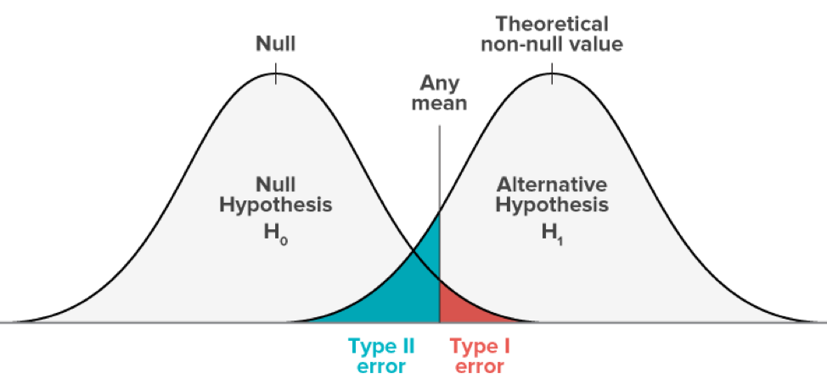
Error Management as the Mechanism Underlying Perceptual Biases
The discrepancy between perception and reality suggests a separate mechanism
may underpin the beauty-is-good stereotype.
The anomalous face overgeneralization hypothesis is supported by evidence.
Perceivers overgeneralize their sensitivity to anomalous cues across all attractiveness levels.
Haselton & Buss, 2000; Zebrowitz & Rhodes, 2004
Notes:
The discrepancy between perception and reality suggests a separate mechanism may underpin the beauty-is-good stereotype.
Men may overperceive sexual interest in women (sexual overperception bias) to avoid missing mating opportunities, while women may underperceive commitment (commitment skepticism bias) to avoid costly pregnancies without paternal support

Slide 20
The Beauty-is-Good Effect as Methodological Artifact
Argument I: When perceivers must infer multiple uncertain traits from
scant cues, they could overly rely on the available cues, inflating correlations
between perceived attributes.
Facial cues
SAT score
Clothing
Intelligence
Attractiveness
Notes:
Despite these theoretical insights, we also raised an alternative perspective suggesting the beauty-is-good stereotype may partially reflect methodological artifacts rather than meaningful psychological associations.

Slide 21
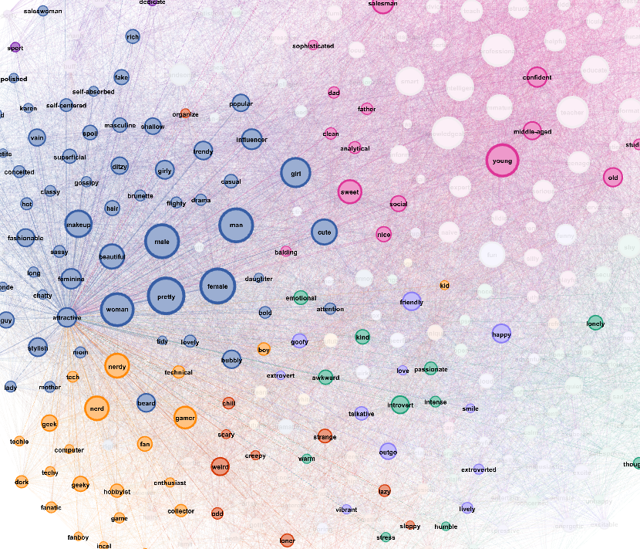
The Beauty-is-Good Effect as Methodological Artifact
Argument II:
Without a clear definition of attractiveness, ratings may simply reflect perception of other related
traits, and judgments of abstract traits like intelligence become self-reinforcing.
Lu & Lin, 2024

Slide 22
Future Directions
Examine the more nuanced relationship between attractiveness and traits. For example, if facial appearance does convey meaningful information about psychological traits, such associations are likely limited in scope and potentially constrained by sexual dimorphism.
Develop standardized, multi-item measures of attractiveness. More rigorous psychometric tools would enable examination of divergent validity, clarifying whether attractiveness represents a distinct construct rather than merely reflecting a composition of perceived traits like intelligence.

Slide 23
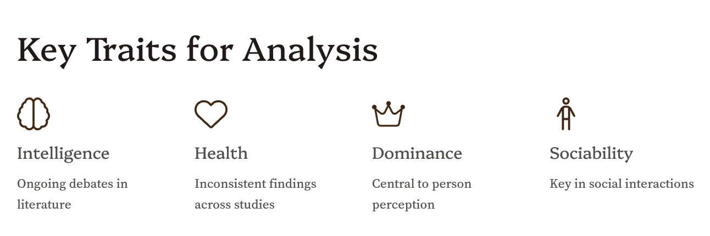


Slide 24
Current Study
The beauty-is-good effect: a genuine phenomenon vs. merely the stereotype?
Incorporate recent findings
Update 30-year-old meta-analyses
Evaluate more recent theories
What are their boundary conditions? Whether predictions generated
by formal models are supported (e.g., reliability)

Slide 25
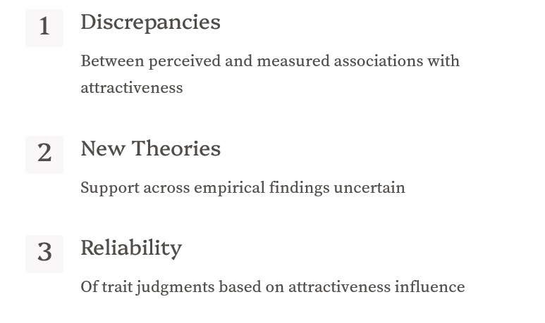
Unsolved Issues
Mitchem et al., 2015

